Slide 1

Internal Revenue Service Project
Shayan Rizvi & Maria Estrada

Slide 2
Origin Story
Once upon a time Maria and Shayan sat down to come up with ideas about their next data analytics project. As they were known to do, their original quest was designed a little too ambitiously that even their TA laughed at the scope of the project and what lied ahead.
They were aiming to look at IRS data from 2011-2017 and then take the 2011-2014 data to see if they could predict what the 2015-2017 would look like. If the predictions were close, then they would be able to predict what the income would look like in 2018 and beyond.
Naturally, their TA, Revan*, laughed and pointed at the two junior data analysts for aiming to set out on such an adventurous quest within a short period of time. He reminded them that they were not reinventing the wheel and that they should look at the internet to see if others had tried to do something similar in the past.
With their laptops fully charged, and their minds determined, they set off to the internet in the hopes of finding another piece of work that was similar to theirs.
*Name not disclosed for anonymity.

Slide 3

New Idea
Could we predict a New Yorker’s salary based on different data from their tax return using machine learning?

Slide 4
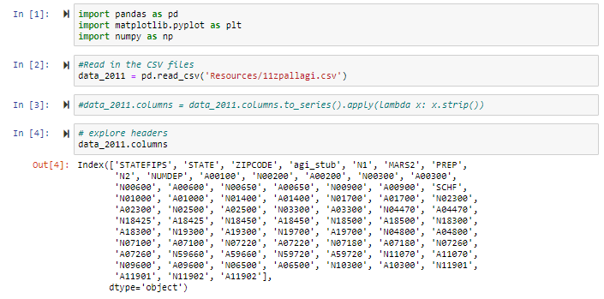
Collecting & Reviewing the Data
We started with 2011 data and explored the data.
Notes:
What were the first five columns we focused on and why. Talk about the shortlist of ten that we originally started with.

Slide 5
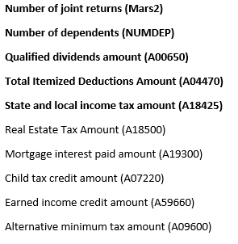
Collecting & Reviewing the Data
We looked through all the information that we could pull and made a shortlist of ten that we though were the most impactful predictors.
Notes:
What were the first five columns we focused on and why. Talk about the shortlist of ten that we originally started with.

Slide 6
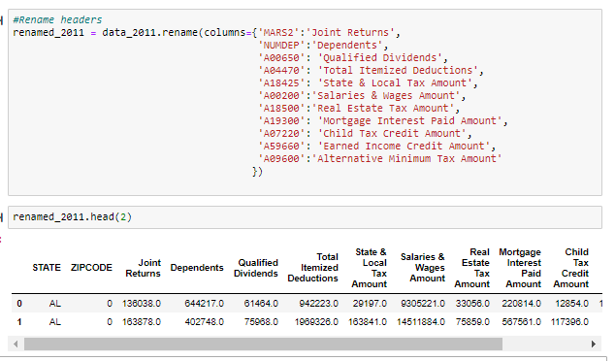
Cleaning the Data
We filtered the five columns we wanted, renamed them, removed all data not listed as New York, and dropped all n/a data.

Slide 7
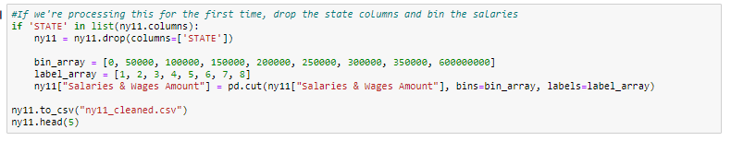
Cleaning the Data
The first set of issues using the tree came from our Salaries & Wages Amount column. When running our code at a later stage we had to turn the column binary which meant we had to address our salaries as bins.

Slide 8
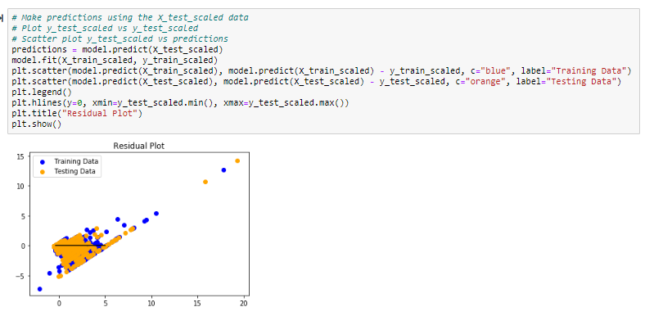
Analyzing the Data
We were ready to test our data using the Ridge model.

Slide 9
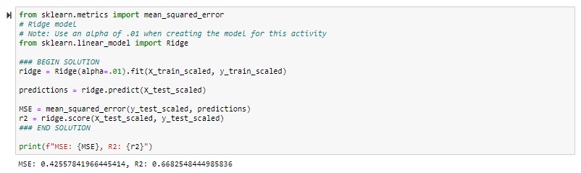
Analyzing the Data
The Ridge got us a score of 66% accuracy.

Slide 10
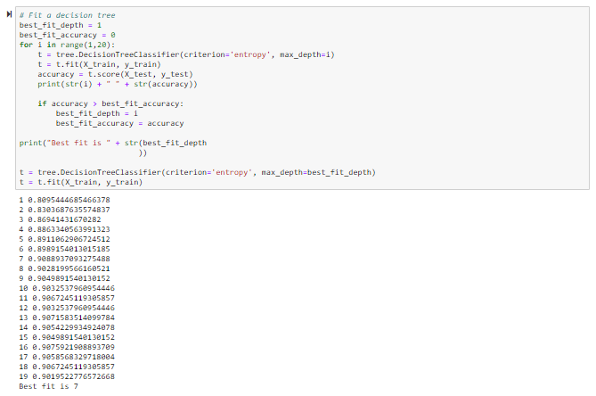
Analyzing the Data
We used a decision tree and that gave us a 90.93% accuracy score.

Slide 11
Analysis Revisit
We went back and added the other five factors we through would make an impact in helping us identify what Salary Bands people belonged to.

Slide 12
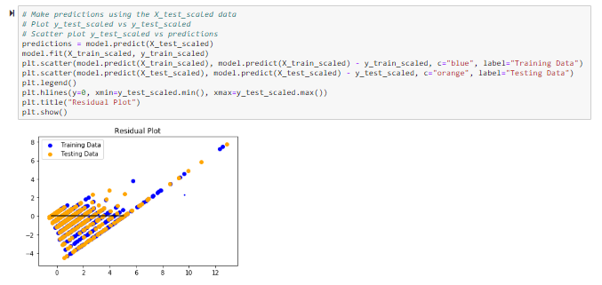
Analysis Revisit
Using the Ridge model we saw significant increase of 75% accuracy.

Slide 13
Analysis Revisit
With our decision tree, the best fit depth increased to 9 and the accuracy only went up to 91.27%.

Slide 14



Limitations
Personal Bias
We selected the columns we though were relevant.
Time
We wanted to insert every columns available to see if that would improve the accuracy significantly.
New Material
We were learning how to make the tree work with our data and debug it.

Slide 15

Questions?

